Slide 1
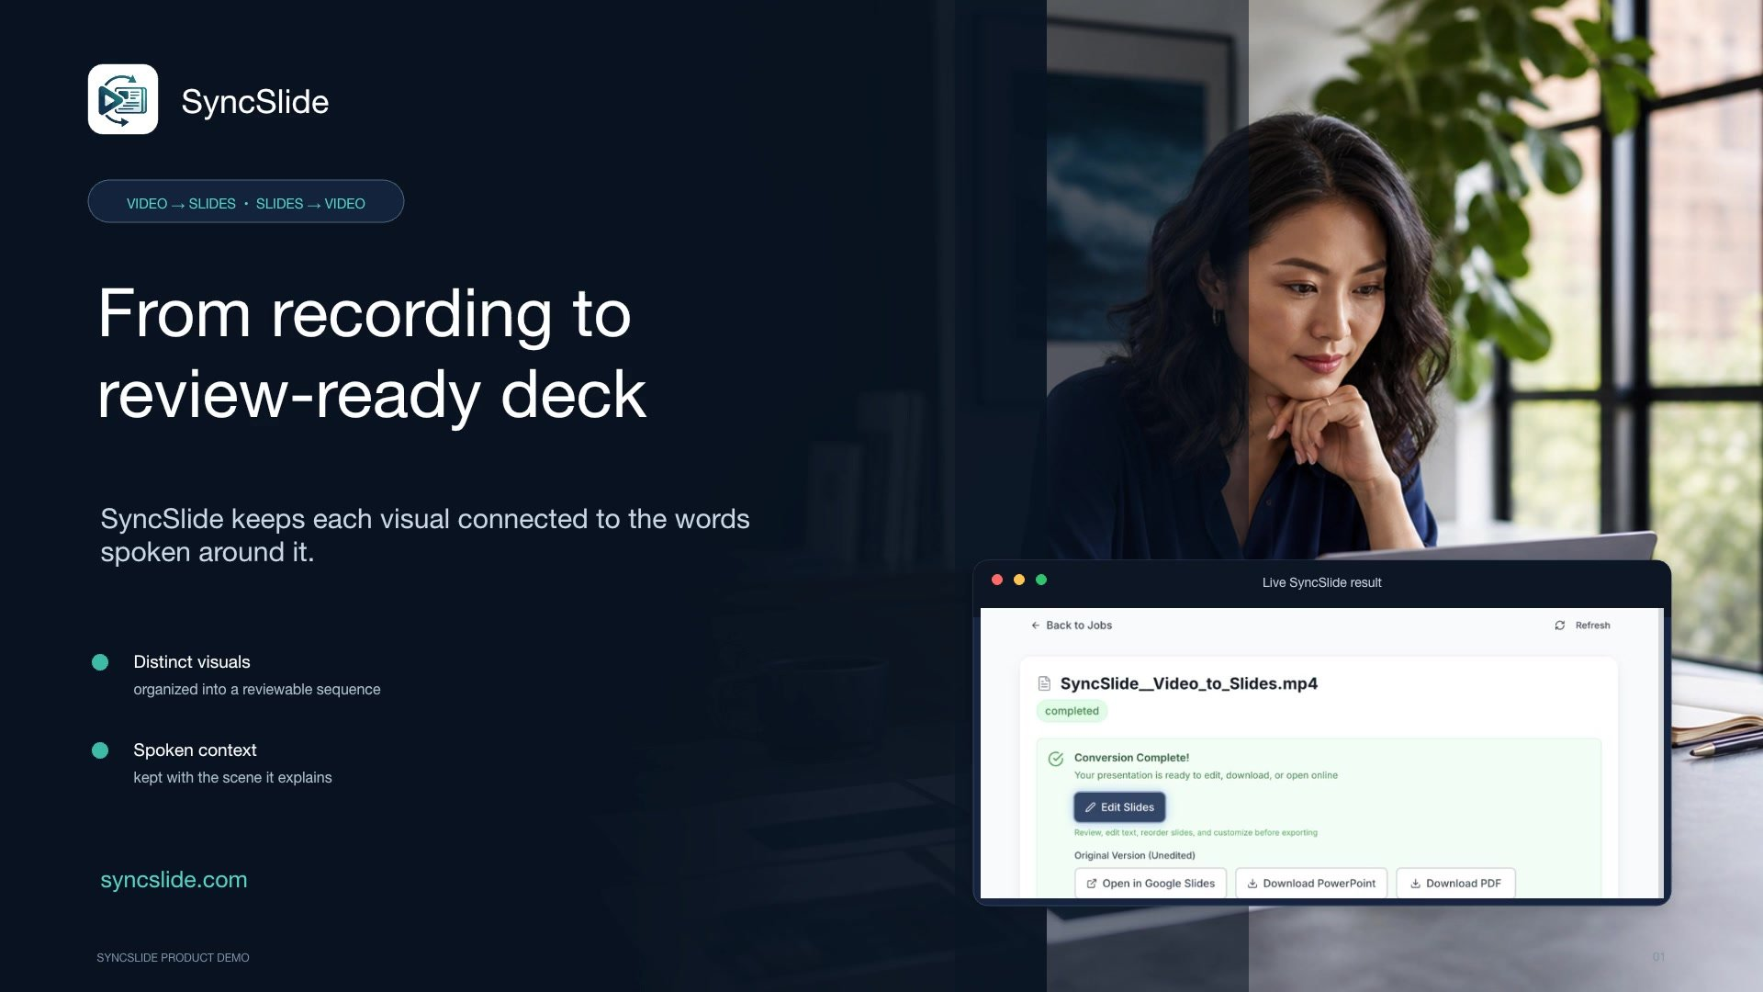
Notes:
Text extracted from slides
SyncSlide
VIDEO TO PRESENTATION
From recording to review-ready deck
SyncSlide keeps each visual connected to the words spoken around it.
Video · Transcript · Slides
Audio transcription
A useful presentation is more than a folder of screenshots. SyncSlide transforms a lecture, webinar, meeting, or screen recording into a sequence ready for review, keeping every distinct visual connected to the words spoken around it.

Slide 2
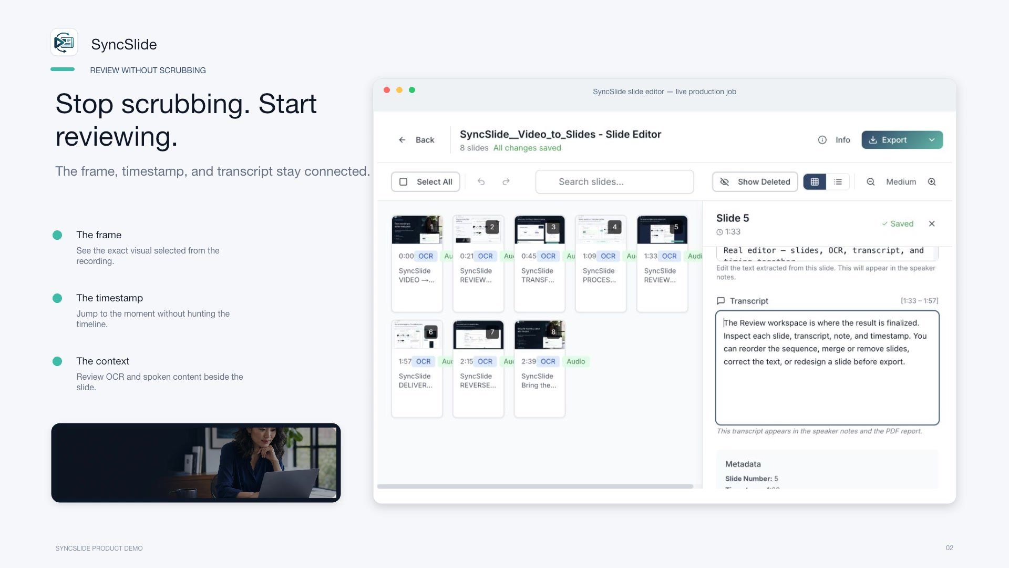
Notes:
Text extracted from slides
THE PROBLEM
Stop scrubbing. Start reviewing.
The frame, timestamp, and transcript stay connected.
Recording timeline
Selected scene
Spoken context
Ready to review
Audio transcription
Manual reviews break the context apart. You replay the timeline, hunt for a visual change, capture a frame, and reconstruct the explanation by hand. SyncSlide keeps the moment, the image, and its spoken context together.

Slide 3
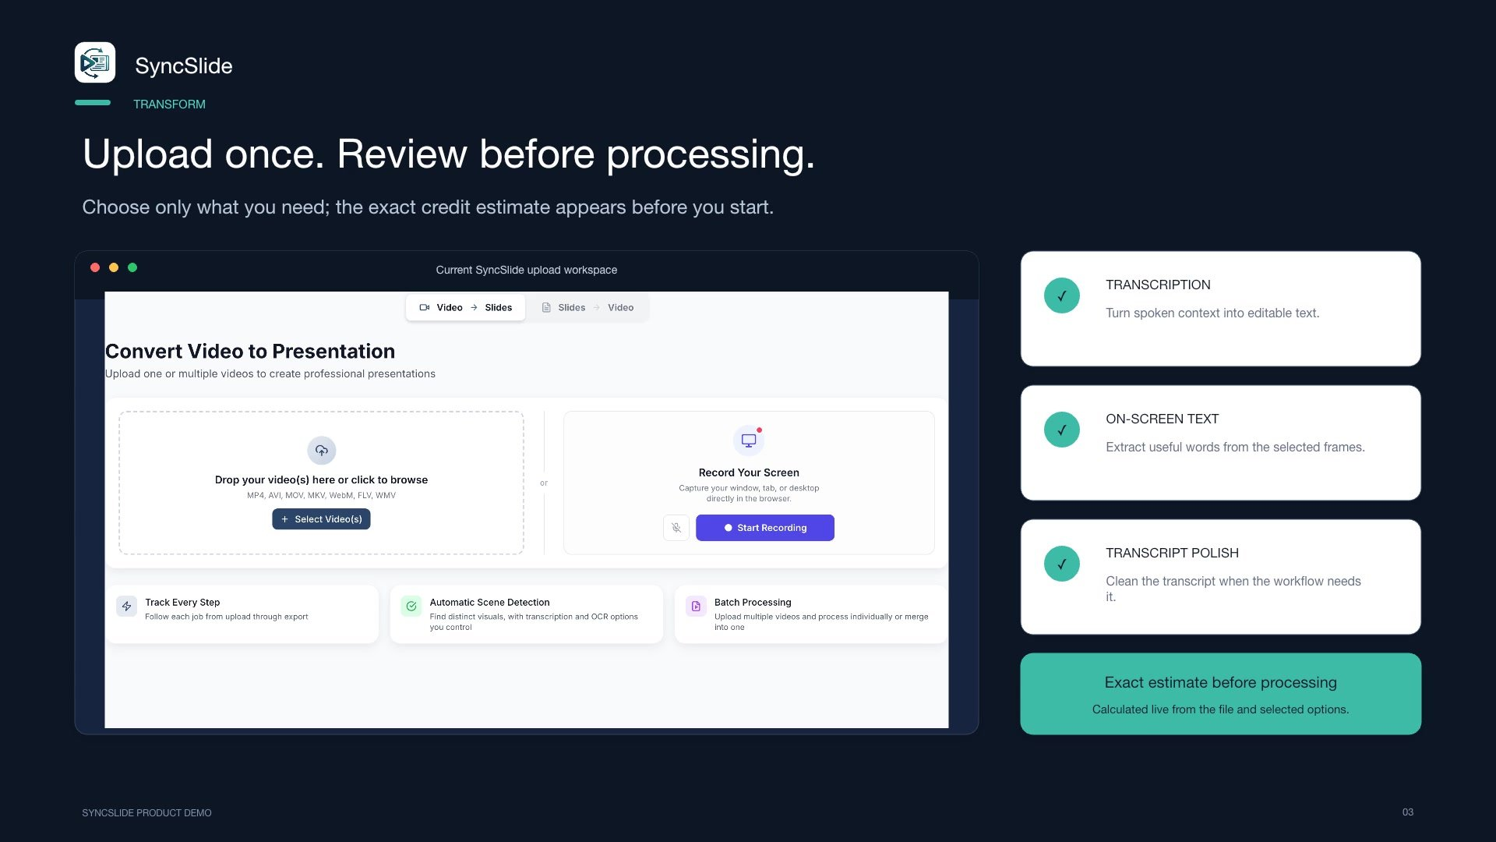
Notes:
Text extracted from slides
TRANSFORM
Upload once. Review before processing.
Choose only what you need; the exact credit estimate appears before you start.
Drop a video or browse
Transcription
On-screen text
Transcript polish
Exact estimate before processing
Calculated live from the file and selected options
Audio transcription
Upload the recording and choose the processing features you need. Before anything starts, SyncSlide displays the exact credit estimate for that file and those options, allowing you to review the total before committing.

Slide 4
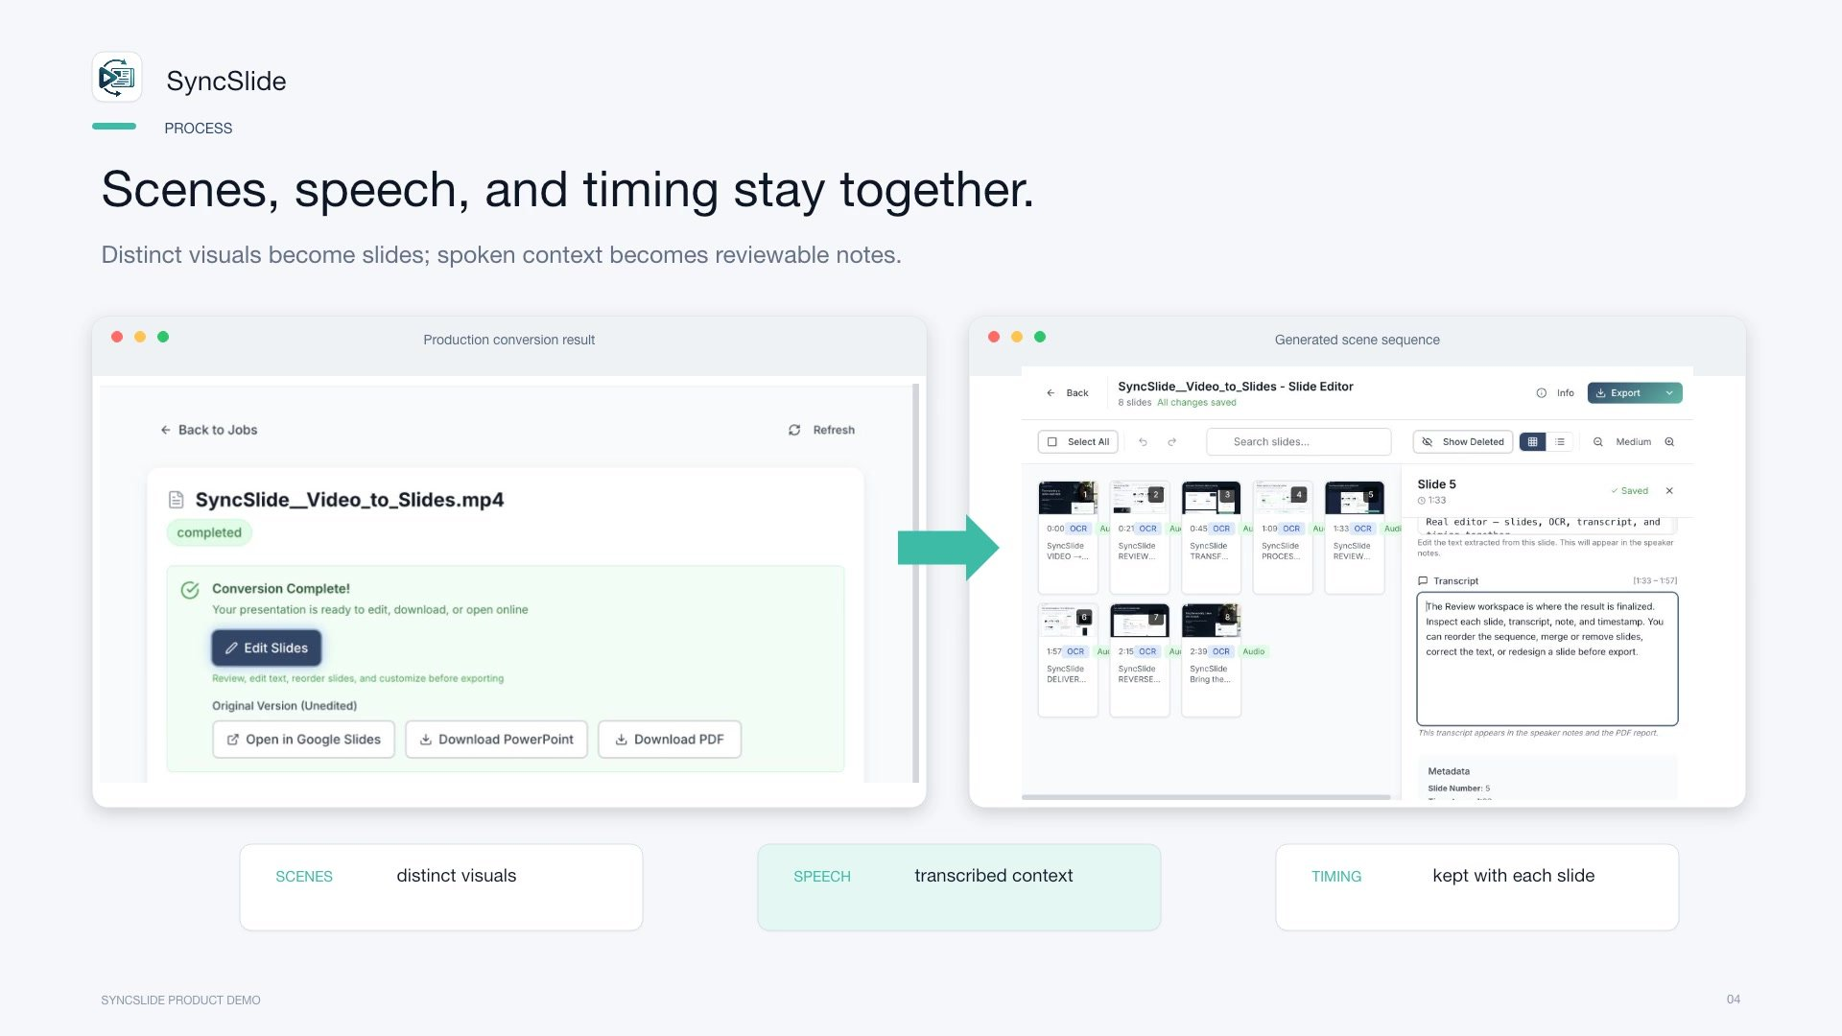
Notes:
Text extracted from slides
PROCESS
Scenes, speech, and timing stay together.
Distinct visuals become slides; spoken context becomes reviewable notes.
Visual scenes
Spoken context
Slide notes
Scene 01
Scene 02
Scene 03
Transcript aligned
Notes ready
Audio transcription
During processing, SyncSlide identifies distinct visual scenes, transcribes the speech, and aligns both on a single timeline. Each selected visual becomes a slide, while the relevant spoken context is converted into reviewable notes.

Slide 5
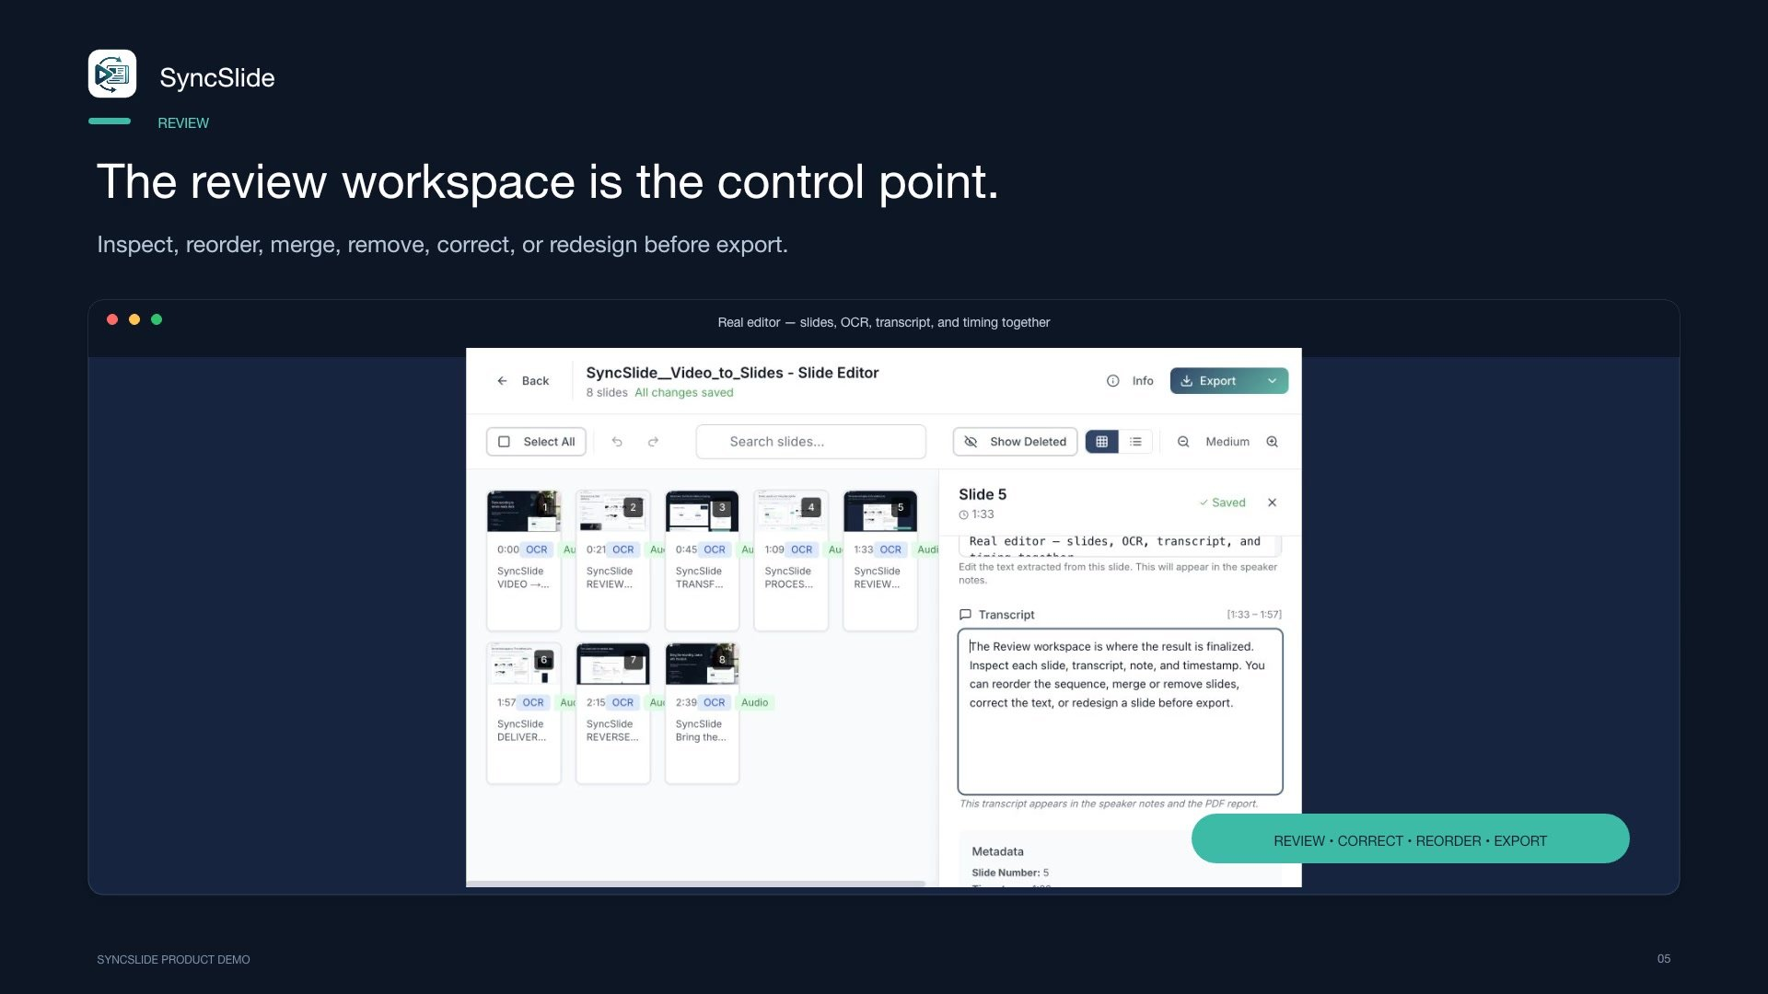
Notes:
Text extracted from slides
REVIEW
The review workspace is the control point.
Inspect, reorder, merge, remove, correct, or redesign before export.
Slide Editor
Reorder
Merge
Remove
Correct text
Redesign slide
Transcript
Notes
Timing
Save changes
Audio transcription
The Review Workspace is where results are finalized. Inspect each slide, transcript, note, and timestamp. Reorder the sequence, merge or remove slides, correct the text, or redesign a slide before export.

Slide 6
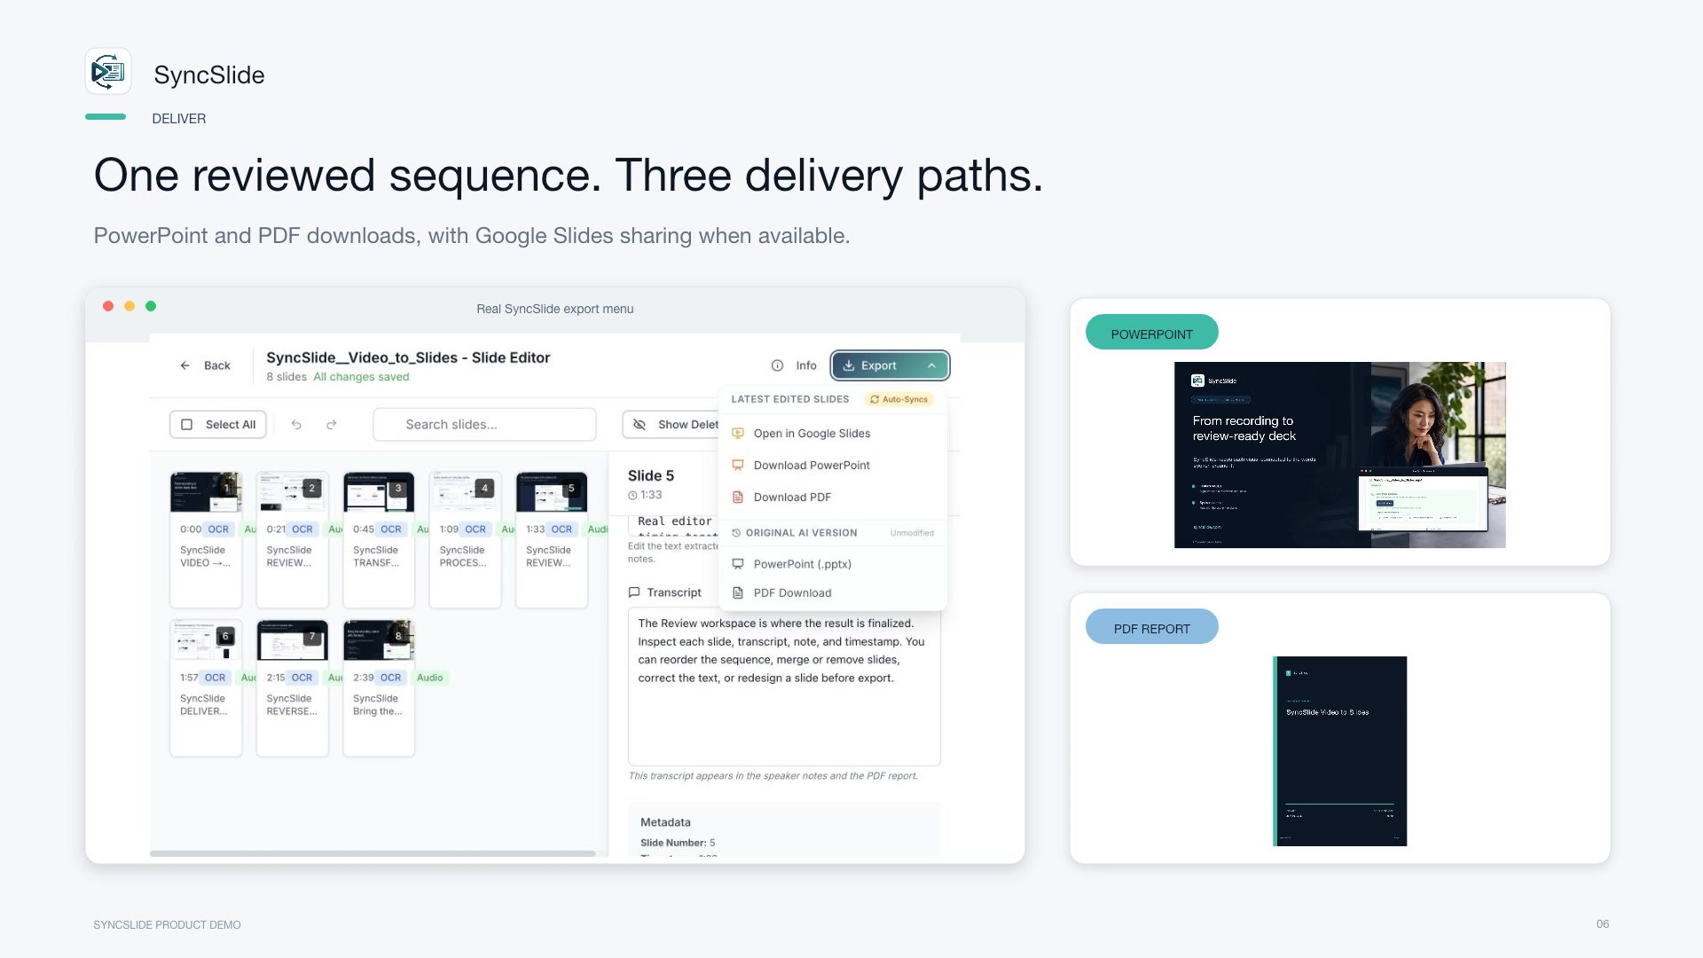
Notes:
Text extracted from slides
DELIVER
One reviewed sequence. Three delivery paths.
PowerPoint and PDF downloads, with Google Slides sharing when available.
Reviewed deck
PowerPoint
PDF
Google Slides
When available
Same approved sequence
Audio transcription
Once the sequence is approved, download it as a PowerPoint or PDF. You can also send the deck to a connected Google Slides account for collaborative review.

Slide 7
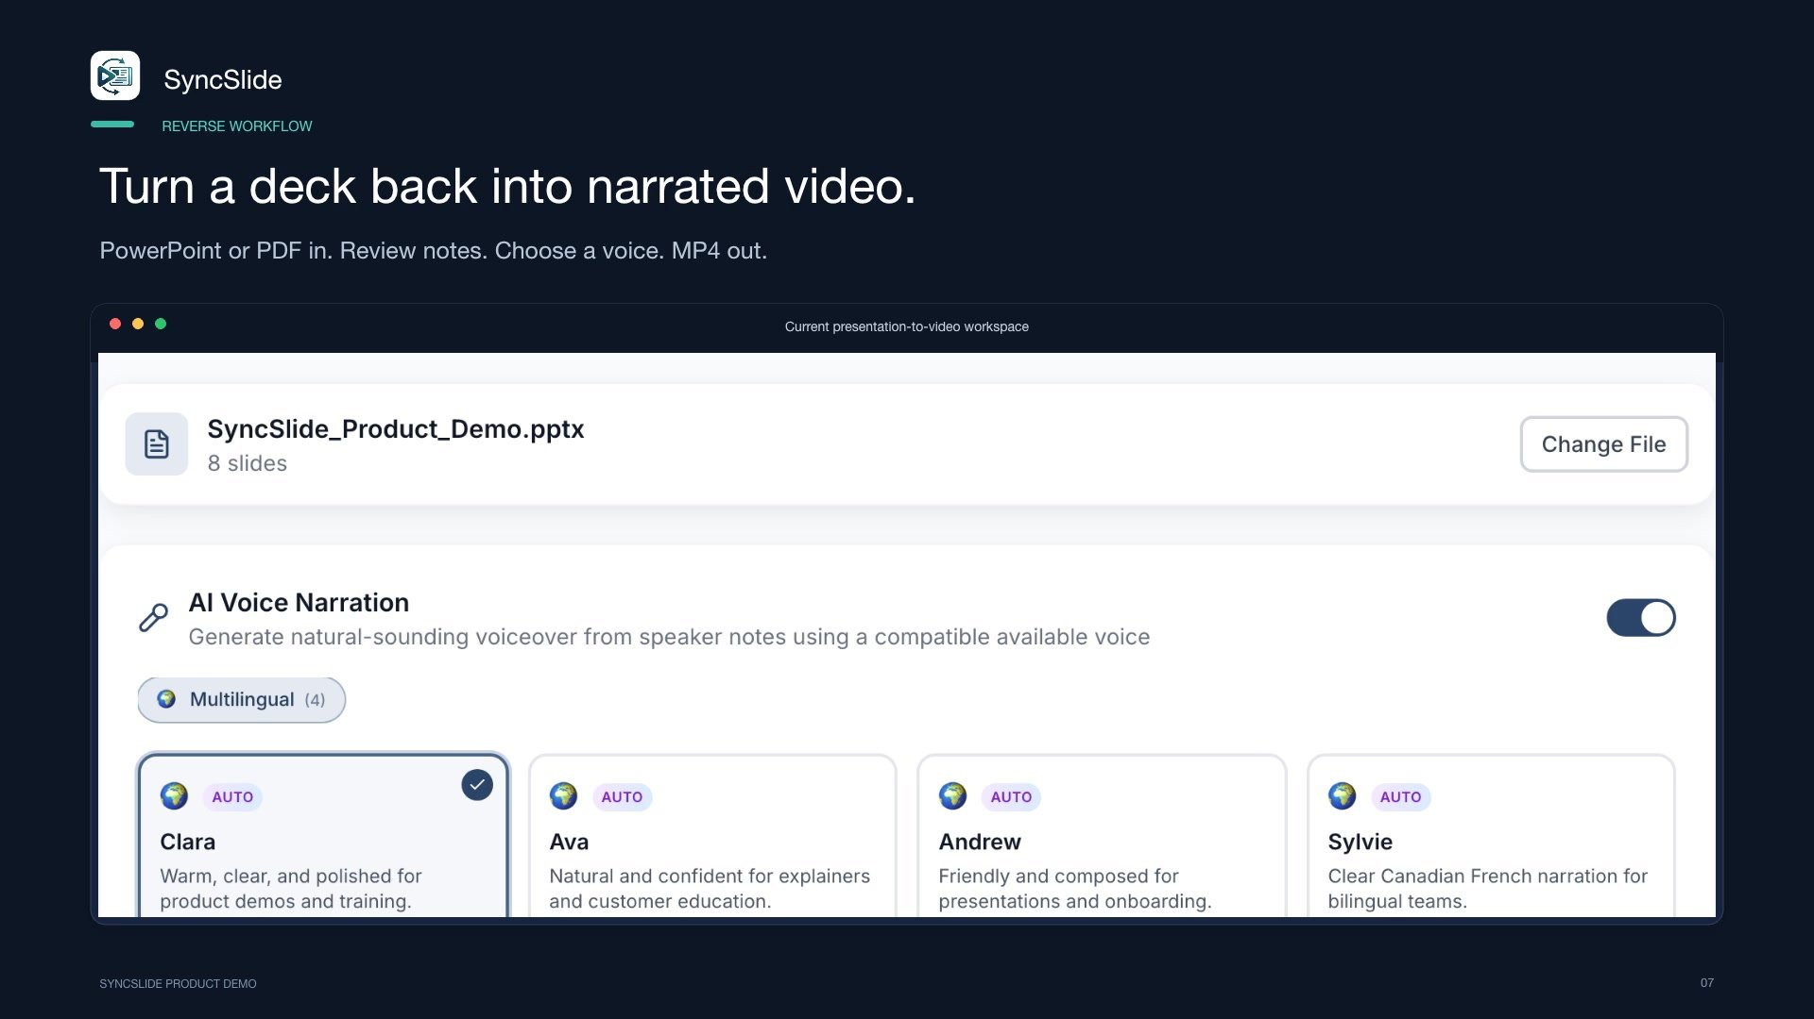
Notes:
Text extracted from slides
REVERSE WORKFLOW
Turn a deck back into narrated video.
PowerPoint or PDF in. Review notes. Choose a voice. MP4 out.
Presentation
Slides and speaker notes
Choose a voice
Preview narration
Review pacing
Narrated MP4
Audio transcription
SyncSlide also works in reverse. Upload a PowerPoint or PDF to review the slides and their speaker notes. Choose a voice, preview the narration and pacing, and generate a shareable MP4 with working audio controls.

Slide 8
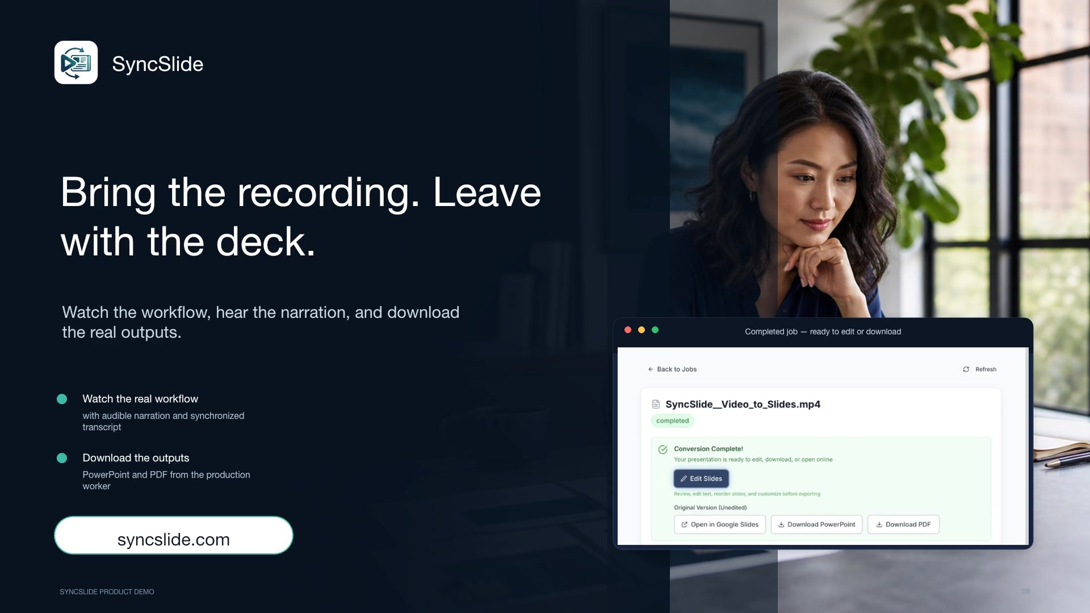
Notes:
Text extracted from slides
SyncSlide
Bring the recording. Leave with the deck.
Watch the narrated demo
Review the synchronized transcript
Download PowerPoint
Download PDF
Review current account options
syncslide.com
Audio transcription
Bring the recording you already have. Review the exact estimate before processing, follow the job from upload to completed slides, and download the result as a PowerPoint or PDF. Alternatively, bring an existing deck, review its speaker notes and voice, and create a narrated MP4.
You can also view current account options on the SyncSlide website.

